Slide 1
Ninja Auto Detailing Phone App
Final Project and Demonstration
EE 523: Mobile Applications For Sensing And Control

Slide 2
Presentation Overview
Project Introduction
App Requirements
App Architecture and Functional Diagram
App Demo
Resources
Questions

Slide 3
Project Introduction

Slide 4
App Requirements
App users/customer should have a option for login into account
New app user should have the function to create new account

Slide 5
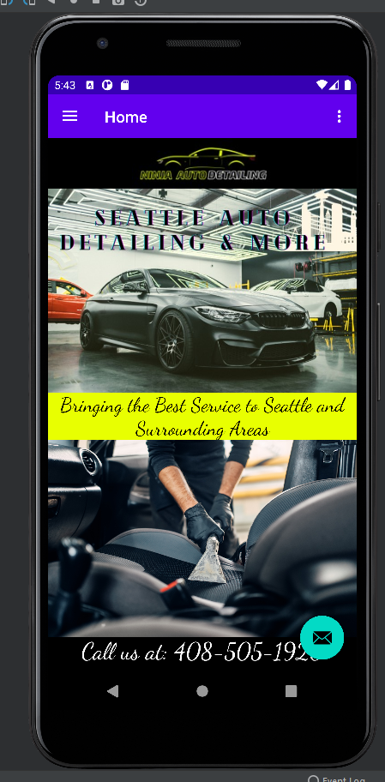
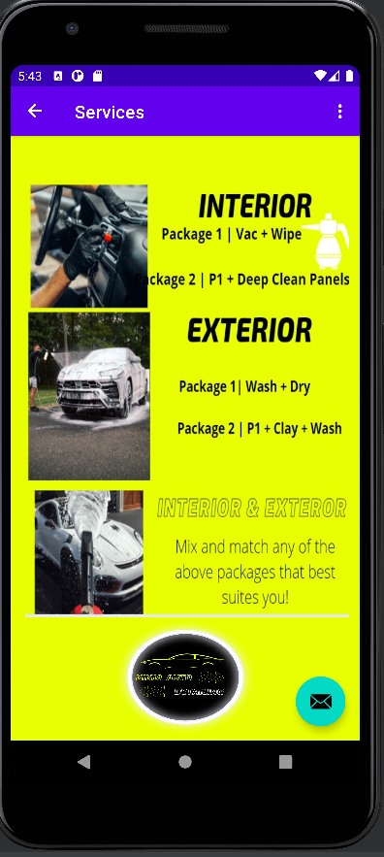
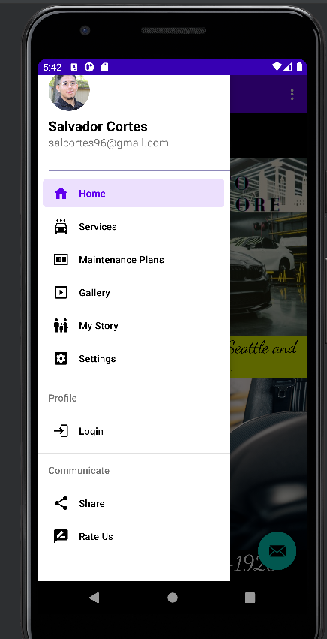

Slide 6
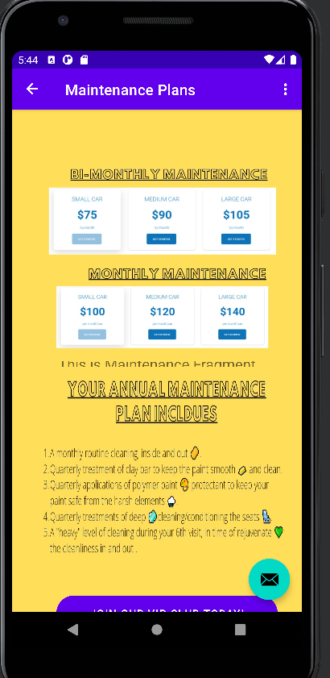
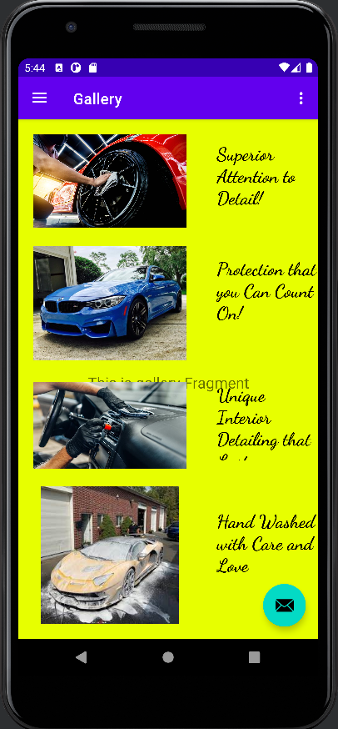
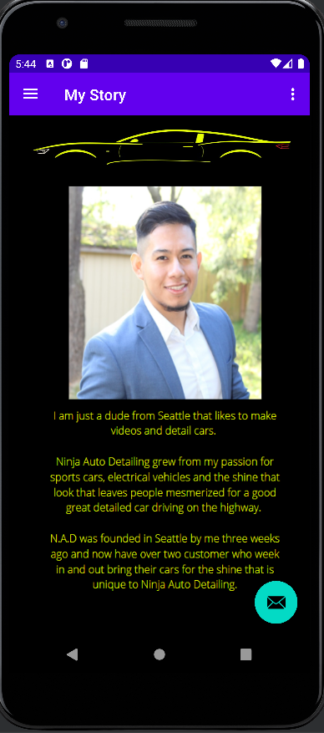
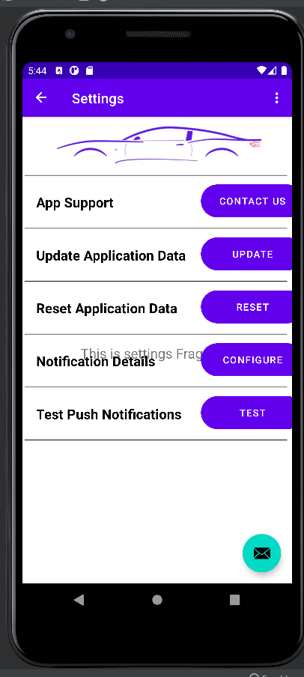

Slide 7
